Slide 1
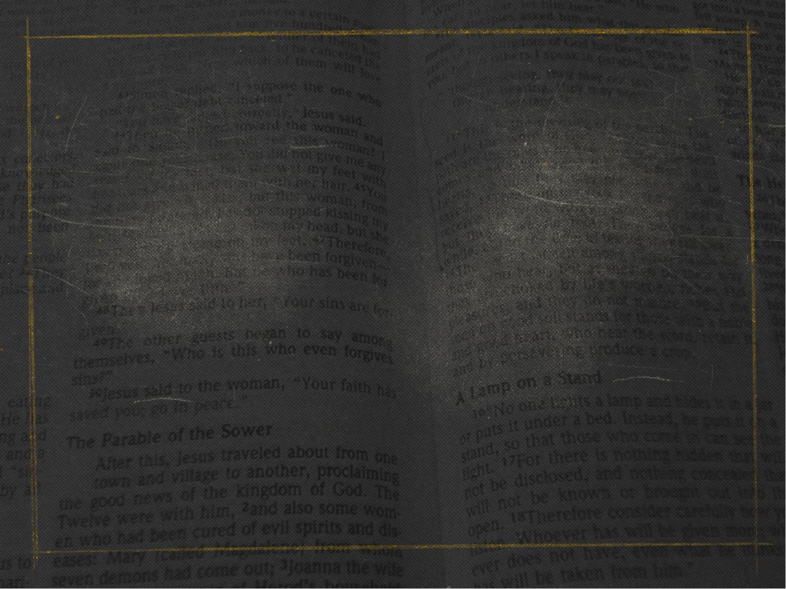
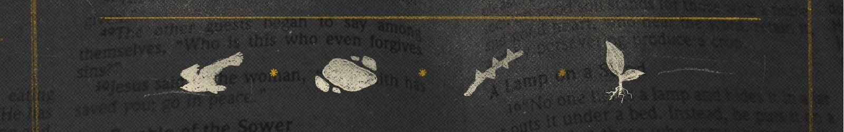
GETTING
SOIL SAMPLES
MATTHEW 13:1-23

Slide 2

Matthew 12:24
24. Now when the Pharisees heard it they said, “This fellow does not cast out demons except by Beelzebub, the ruler of the demons.”

Slide 3
John 1:11
11. He came to His own, and His own did not receive Him.

Slide 4
Zechariah 12:10
10. “And I will pour on the house of David and on the inhabitants of Jerusalem the Spirit of grace and supplication; then they will look on Me

Slide 5
Zechariah 12:10
whom they pierced. Yes, they will mourn for Him as one mourns for his only son, and grieve for Him as one grieves for a firstborn.

Slide 6
Zechariah 14:8-9
8. And in that day it shall be – that living waters shall flow from Jerusalem, half of them toward the eastern sea and half of them toward the western

Slide 7
Zechariah 14:8-9
sea; in both summer and winter it shall occur.

Slide 8
Zechariah 14:8-9
9. And the Lord shall be King over all the earth. In that day it shall be “The Lord is one,” and His name one.

Slide 9
Romans 11:26-27
26. And so all Israel will be saved, as it is written: “The Deliverer will come out of Zion, and He will turn away ungodliness from Jacob;

Slide 10
Romans 11:26-27
27. For this is My covenant with them, when I take away their sins.”

Slide 11
The church is a
MYSTERY until
revealed here.

Slide 12
Israel’s salvation is
POSTPONED.

Slide 13
His OUTWARD
kingdom delayed.

Slide 14
John 1:11-12
11. He came to His own, and His own did not receive Him.

Slide 15
John 1:11-12
12. But as many as received Him, to them He gave the right to become children of God, to those who believe in His name:

Slide 16
Matthew 13:11
11. He answered and said to them, “Because it has been given to you to know the mysteries of the kingdom of heaven, but to them it has not been given.

Slide 17
PARABLE:
means to throw alongside of

Slide 18
Matthew 13:1-2
1. On the same day Jesus went out of the house and sat by the sea.

Slide 19
Matthew 13:1-2
2. And great multitudes were gathered together to Him, so that He got into a boat and sat; and the whole multitude stood on the shore.

Slide 20
Matthew 12:46-47
46. While He was still talking to the multitudes, behold, His mother and brothers stood outside, seeking to speak with Him.

Slide 21
Matthew 12:46-47
47. Then one said to Him, “Look, Your mother and Your brothers are standing outside, seeking to speak with You.”

Slide 22
Matthew 13:3-9
3. Then He spoke many things to them in parables, saying: “Behold, a sower went out to sow.

Slide 23
Matthew 13:3-9
4. And as he sowed, some seed fell by the wayside; and the birds came and devoured them.

Slide 24
Matthew 13:3-9
5. Some fell on stony places, where they did not have much earth; and they immediately sprang up because they had no depth of earth.

Slide 25
Matthew 13:3-9
6. But when the sun was up they were scorched, and because they had no root they withered away.

Slide 26
Matthew 13:3-9
7. And some fell among thorns, and the thorns sprang up and choked them.

Slide 27
Matthew 13:3-9
8. But others fell on good ground and yielded a crop: some a hundredfold, some sixty, some thirty.

Slide 28
Matthew 13:3-9
9. He who has ears to hear, let him hear!”

Slide 29
Only those who
ACCEPTED the King
could UNDERSTAND
the King.

Slide 30
Matthew 13:10-17
10. And the disciples came and said to Him, “Why do You speak to them in parables?”

Slide 31
Matthew 13:10-17
11. He answered and said to them, “Because it has been given to you to know the mysteries of the kingdom of heaven, but to them it has not been given.

Slide 32
Matthew 13:10-17
12. For whoever has, to him more will be given, and he will have abundance; but whoever does not have, even what he has will be taken away from him.

Slide 33
Matthew 13:10-17
13. Therefore I speak to them in parables, because seeing they do not see, and hearing they do not hear, nor do they understand.

Slide 34
Matthew 13:10-17
14. And in them the prophecy of Isaiah is fulfilled, which says: ‘Hearing you will hear and shall not understand, and seeing you will see and not perceive;

Slide 35
Matthew 13:10-17
15. For the hearts of this people have grown dull. Their ears are hard of hearing, and their eyes they have closed, lest they should see with their eyes

Slide 36
Matthew 13:10-17
and hear with their ears, lest they should understand with their hearts and turn, so that I should heal them.’

Slide 37
Matthew 13:10-17
16. But blessed are your eyes for they see, and your ears for they hear;

Slide 38
Matthew 13:10-17
17. for assuredly, I say to you that many prophets and righteous men desired to see what you see, and did not see it, and to hear what you hear, and did not hear it.

Slide 39
Why parables?
to REVEAL meaning to those who receive Him

Slide 40
Why parables?
to CONCEAL meaning from those who don’t receive Him

Slide 41
John 12:31
31. Now is the judgment of this world; now the ruler of this world will be cast out.

Slide 42
John 6:37
37. All that the Father gives Me will come to Me, and the one who comes to Me I will by no means cast out.

Slide 43
the
UNRESPONSIVE
heart

Slide 44
Matthew 13:18-19
18. “Therefore hear the parable of the sower:

Slide 45
Matthew 13:18-19
19. When anyone hears the word of the kingdom, and does not understand it, then the wicked one comes and snatches away what was sown in his heart.

Slide 46
Matthew 13:18-19
This is he who received seed by the wayside.

Slide 47
Psalm 14:1
1. The fool has said in his heart, “There is no God.” They are corrupt, they have done abominable works, there is none who does good.

Slide 48
the
SUPERFICIAL
heart

Slide 49
Matthew 13:20-21
20. But he who received the seed on stony places, this is he who hears the word and immediately receives it with joy;

Slide 50
Matthew 13:20-21
21. yet he has no root in himself, but endures only for a while. For when tribulation or persecution arises because of the word, immediately he stumbles.

Slide 51
1 Timothy 3:12
12. Let deacons be the husbands of one wife, ruling their children and their own houses well.

Slide 52
the
WORLDLY
heart

Slide 53
Matthew 13:22
22. Now he who received seed among the thorns is he who hears the word, and the cares of this world and the deceitfulness of riches choke the word, and he becomes unfruitful.

Slide 54
1 John 2:15-16
15. Do not love the world or the things in the world. If anyone loves the world, the love of the Father is not in him.

Slide 55
1 John 2:15-16
16. For all that is in the world – the lust of the flesh, the lust of the eyes, and the pride of life – is not of the Father but is of the world.

Slide 56
the
RESPONSIVE
heart

Slide 57
Matthew 13:23
23. But he who received seed on the good ground is he who hears the word and understands it, who indeed bears fruit and produces: some a hundredfold, some sixty, some thirty.”

Slide 58
Ephesians 2:10
10. For we are His workmanship, created in Christ Jesus for good works, which God prepared beforehand that we should walk in them.

Slide 59
GETTING
SOIL SAMPLES
MATTHEW 13:1-23

