Slide 1
fAITH
of
Hebrews 11:23-29

Slide 2
John 5:45-47
45. Do not think that I shall accuse you to the Father; there is one who accuses you – Moses, in whom you trust.

Slide 3
John 5:45-47
46. For if you believed Moses, you would believe Me; for he wrote about Me.

Slide 4
John 5:45-47
47. But if you do not believe his writings, how will you believe My words?”

Slide 5
Faith’s foundation is laid at HOME.

Slide 6
Hebrews 11:23
23. By faith Moses, when he was born, was hidden three months by his parents, because they saw he was a beautiful child; and they were not afraid of the king’s command.

Slide 7
Exodus 1:16-22
16. and he (the king) said, “When you do the duties of a midwife for the Hebrew women, and see them on the birthstools, if it is a son, then you shall kill him; but if it is a daughter, then she shall live.”

Slide 8
Exodus 1:16-22
17. But the midwives feared God, and did not do as the king of Egypt commanded them, but saved the male children alive.

Slide 9
Exodus 1:16-22
18. So the king of Egypt called for the midwives and said to them, “Why have you done this thing, and saved the male children alive?”

Slide 10
Exodus 1:16-22
19. And the midwives said to Pharaoh, “Because the Hebrew women are not like the Egyptian women; for they are lively and give birth before the midwives come to them.”

Slide 11
Exodus 1:16-22
20. Therefore God dealt well with the midwives, and the people multiplied and grew very mighty.

Slide 12
Exodus 1:16-22
21. And so it was, because the midwives feared God, that He provided households for them.

Slide 13
Exodus 1:16-22
22. So Pharaoh commanded all his people, saying, “Every son who is born you shall cast into the river, and every daughter you shall save alive.”

Slide 14
Exodus 2:1-10
1. And a man of the house of Levi went and took as wife a daughter of Levi.

Slide 15
Exodus 2:1-10
1. And a man of the house of Levi went and took as wife a daughter of Levi.

Slide 16
Exodus 2:1-10
2. So the woman conceived and bore a son. And when she saw that he was a beautiful child, she hid him three months.

Slide 17
Exodus 2:1-10
3. But when she could no longer hide him, she took an ark of bulrushes for him, daubed it with asphalt and pitch, put the child in it, and laid it in the reeds by the river’s bank.

Slide 18
Exodus 2:1-10
4. And his sister stood afar off, to know what would be done to him.

Slide 19
Exodus 2:1-10
5. Then the daughter of Pharaoh came down to bathe at the river. And her maidens walked along the riverside; and when she saw the ark among the reeds, she sent her maid to get it.

Slide 20
Exodus 2:1-10
6. And when she opened it, she saw the child, and behold, the baby wept. So she had compassion on him, and said, “This is one of the Hebrews’ children.”

Slide 21
Exodus 2:1-10
7. Then his sister said to Pharaoh’s daughter, “Shall I go and call a nurse for you from the Hebrew women, that she may nurse the child for you?”

Slide 22
Exodus 2:1-10
8. And Pharaoh’s daughter said to her, “Go.” So the maiden went and called the child’s mother.

Slide 23
Exodus 2:1-10
9. Then Pharaoh’s daughter said to her, “Take this child away and nurse him for me, and I will give you your wages.” So the woman took the child and nursed him.

Slide 24
Exodus 2:1-10
10. And the child grew, and she brought him to Pharaoh’s daughter, and he became her son. So she called his name Moses, saying, “Because I drew him out of the water.”

Slide 25
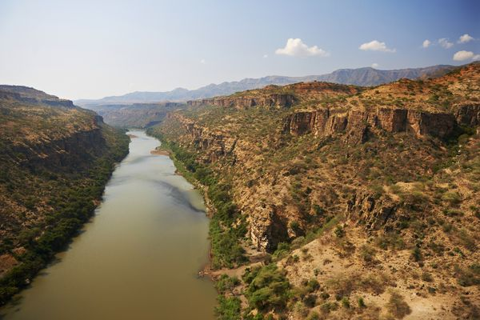

Slide 26
Faith enables us to
FACE tests.

Slide 27
Faith CONQUERS
natural fears.

Slide 28
2 Timothy 1:7
7. For God has not given us a spirit of fear, but of power and of love and of a sound mind.

Slide 29
Faith enables us to make
HARD CHOICES.

Slide 30
Hebrews 11:24-27
24. By faith Moses, when he became of age, refused to be called the son of Pharaoh’s daughter,

Slide 31
Hebrews 11:24-27
25. choosing rather to suffer affliction with the people of God than to enjoy the passing pleasures of sin,

Slide 32
Hebrews 11:24-27
26. esteeming the reproach of Christ greater riches than the treasures in Egypt; for he looked to the reward.

Slide 33
Hebrews 11:24-27
27. By faith he forsook Egypt, not fearing the wrath of the king; for he endured as seeing Him who is invisible.

Slide 34
Faith empowered him to STAND FIRM.

Slide 35
Faith enables you to TRUST God in humanly IMPOSSIBLE situations.

Slide 36
Hebrews 11:28-29
28. By faith he kept the Passover and the sprinkling of blood, lest he who destroyed the firstborn should touch them.

Slide 37
Hebrews 11:28-29
29. By faith they passed through the Red Sea as by dry land, whereas the Egyptians, attempting to do so, were drowned.

Slide 38
fAITH
of
Hebrews 11:23-29

