Slide 1
“DID YOU USE SOAP?”
MATTHEW 7:20-29

Slide 2
It’s dangerous to
HEAR God’s Word
and not OBEY it.

Slide 3
Romans 10:3
3. For they being ignorant of God’s righteousness, and seeking to establish their own righteousness, have not submitted to the righteousness of God.

Slide 4
James 1:22
22. But be doers of the word, and not hearers only, deceiving yourselves.

Slide 5
Luke 6:46
46. “But why do you call Me ‘Lord, Lord,’ and not do the things which I say?

Slide 6
Matthew 7:21-23
21. “Not everyone who says to Me, ‘Lord, Lord,’ shall enter the kingdom of heaven, but he who does the will of My Father in heaven.

Slide 7
Matthew 7:21-23
22. Many will say to Me in that day, ‘Lord, Lord, have we not prophesied in Your name, cast out demons in Your name, and done many wonders in Your name?’

Slide 8
Matthew 7:21-23
23. And then I will declare to them, ‘I never knew you; depart from Me, you who practice lawlessness!’

Slide 9
WORDS do not
substitute for
obedience.

Slide 10
True faith is
OBEDIENT to what
God says.

Slide 11
The Holy Spirit
INDWELLS the
true believer.

Slide 12
Romans 8:9
9. But you are not in the flesh but in the Spirit, if indeed the Spirit of God dwells in you. Now if anyone does not have the Spirit of Christ,
he is not His.

Slide 13
Matthew 7:24-27
24. “Therefore whoever hears these sayings of Mine, and does them, I will liken him to a wise man who built his house on the rock:

Slide 14
Matthew 7:24-27
25. and the rain descended, the floods came, and the winds blew and beat on that house; and it did not fall, for it was founded on the rock.

Slide 15
Matthew 7:24-27
26. “But everyone who hears these sayings of Mine, and does not do them, will be like a foolish man who built his house on the sand:

Slide 16
Matthew 7:24-27
27. and the rain descended, the floods came, and the winds blew and beat on that house; and it fell. And great was its fall.”

Slide 17
Everyone’s
HOUSE may appear
to be beautiful.

Slide 18
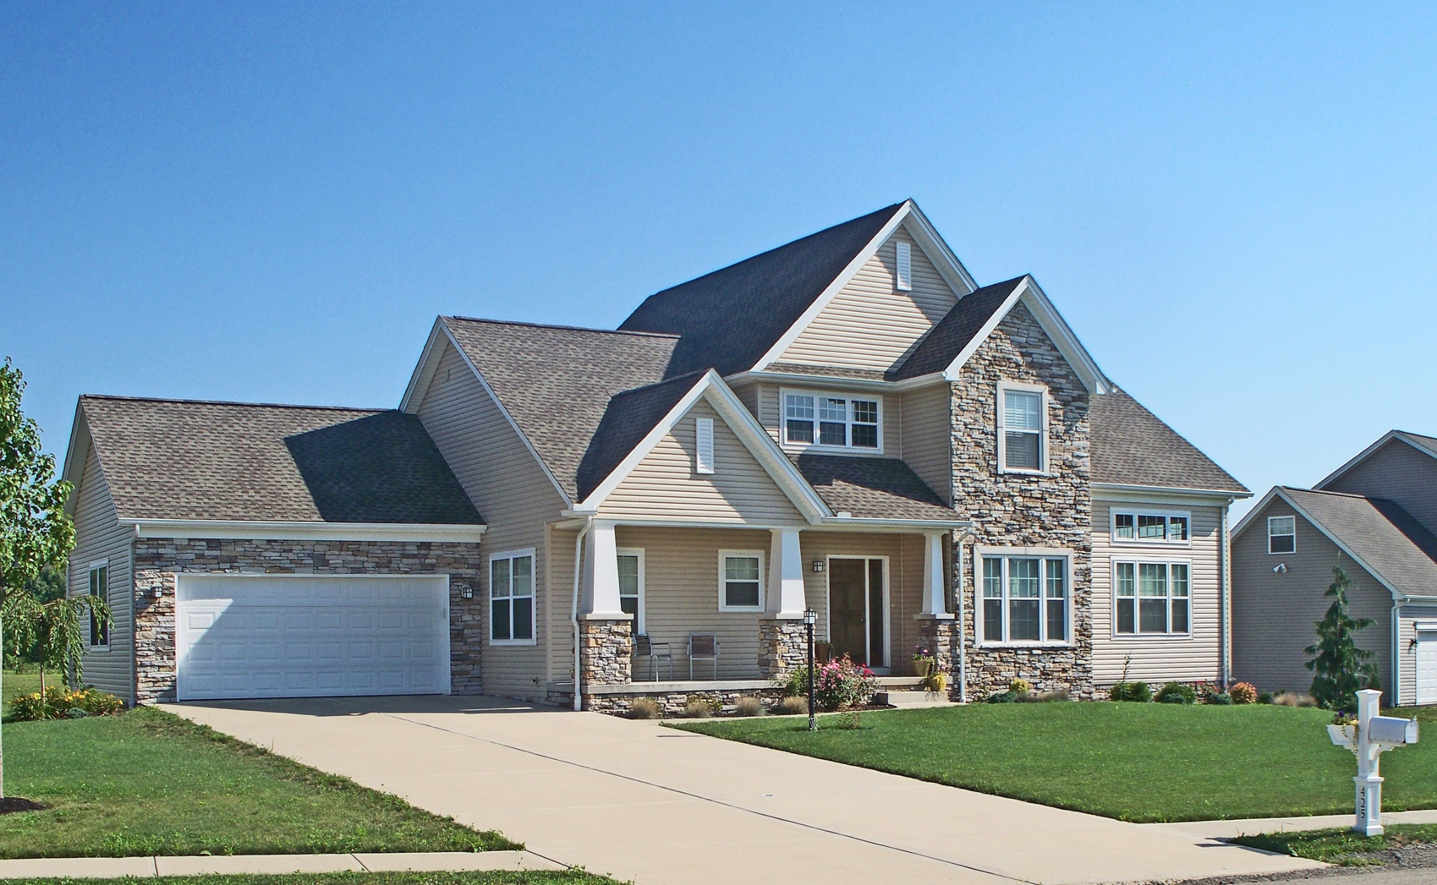

Slide 19
Judgment will
come to ALL.

Slide 20
Everyone is
responsible for what
they DO with what
they HEAR.

Slide 21
Matthew 7:28-29
28. And so it was, when Jesus had ended these sayings, that the people were astonished at His teaching,

Slide 22
Matthew 7:28-29
29. for He taught them as one having authority, and not as the scribes.

Slide 23
Romans 5:5
5. Now hope does not disappoint, because the love of God has been poured out in our hearts by the Holy Spirit who was given to us.

Slide 24
“DID YOU USE SOAP?”
MATTHEW 7:20-29

