Slide 1
A Faith For
MARTYRS
Hebrews
11:32-40

Slide 2
If deliverance or healing will GLORIFY God, He can and will do it.

Slide 3
If deliverance will
NOT glorify Him, He will NOT do it.

Slide 4
EVERYTHING God does glorifies Himself.

Slide 5
Absence of
deliverance does not
mean a LACK of faith.

Slide 6
2 Corinthians 12:7-10
7. And lest I should be exalted above measure by the abundance of the revelations, a thorn in the flesh was given to me, a messenger of Satan to buffet me, lest I be exalted above measure.

Slide 7
2 Corinthians 12:7-10
8. Concerning this thing I pleaded with the Lord three times that it might depart from me.

Slide 8
2 Corinthians 12:7-10
9. And He said to me, “My grace is sufficient for you, for My strength is made perfect in weakness.” Therefore most gladly I will rather boast in my infirmities, that the power of Christ may rest upon me.

Slide 9
2 Corinthians 12:7-10
10. Therefore I take pleasure in infirmities, in reproaches, in needs, in persecutions, in distresses, for Christ’s sake. For when I am weak, then I am strong.

Slide 10
Hebrews 11:30-40
30. By faith the walls of Jericho fell down after they were encircled for seven days.

Slide 11
Hebrews 11:30-40
31. By faith the harlot Rahab did not perish with those who did not believe, when she had received the spies with peace.

Slide 12
Hebrews 11:30-40
32. And what more shall I say? For the time would fail me to tell of Gideon and Barak and Samson and Jephthah, also of David and Samuel and the prophets:

Slide 13
Hebrews 11:30-40
33. who through faith subdued kingdoms, worked righteousness, obtained promises, stopped the mouths of lions,

Slide 14
Hebrews 11:30-40
34. quenched the violence of fire, escaped the edge of the sword, out of weakness were made strong, became valiant in battle, turned to flight the armies of the aliens.

Slide 15
Hebrews 11:30-40
35. Women received their dead raised to life again. Others were tortured, not accepting deliverance, that they might obtain a better resurrection.

Slide 16
Hebrews 11:30-40
36. Still others had trial of mockings and scourgings, yes, and of chains and imprisonment.

Slide 17
Hebrews 11:30-40
37. They were stoned, they were sawn in two, were tempted, were slain with the sword. They wandered about in sheepskins and goatskins, being destitute, afflicted, tormented

Slide 18
Hebrews 11:30-40
38. of whom the world was not worthy. They wandered in deserts and mountains, in dens and caves of the earth.

Slide 19
Hebrews 11:30-40
39. And all these, having obtained a good testimony through faith, did not receive the promise,

Slide 20
Hebrews 11:30-40
40. God having provided something better for us, that they should not be made perfect apart from us.

Slide 21
Faith is seen in our OBEDIENCE.

Slide 22
Faith is seen in
ACTING on God’s
promises.

Slide 23
Faith is seen in our
SEPARATION from the world.

Slide 24
Faith trusts and obeys
even when He does not
DELIVER us.

Slide 25
Daniel 3:16-18
16. Shadrach, Meshach, and Abednego answered and
said to the king, “O Nebuchadnezzar, we have no need to answer you in this matter.

Slide 26
Daniel 3:16-18
17. If that is the case, our God whom we serve is able to deliver us from the burning fiery furnace, and He will deliver us from your hand,
O king.

Slide 27
Daniel 3:16-18
18. But if not, let it be known to you, O king, that we do not serve your gods, nor will we worship the gold image which you have set up.

Slide 28
GOD does not see or
value people the
same as MAN does.

Slide 29
Hebrews 11:36-40
36. Still others had trial of mockings and scourgings, yes, and of chains and imprisonment.

Slide 30
Hebrews 11:36-40
37. They were stoned, they were sawn in two, were tempted, were slain with the sword. They wandered about in sheepskins and goatskins, being destitute, afflicted, tormented

Slide 31
Hebrews 11:36-40
38. of whom the world was not worthy. They wandered in deserts and mountains, in dens and caves of the earth.

Slide 32
Hebrews 11:36-40
39. And all these, having obtained a good testimony through faith, did not receive the promise,

Slide 33
Hebrews 11:36-40
40. God having provided something better for us, that they should not be made perfect apart from us.

Slide 34
God says the world
isn’t even WORTHY
of these martyrs.

Slide 35
1 Corinthians 4:13
13. being defamed, we entreat. We have been made as the filth of the world, the offscouring of all things until now.

Slide 36
Not everyone will be DELIVERED
miraculously.

Slide 37
God does not have
to HEAL to PROVE
our faith.

Slide 38
It takes more faith to ENDURE a trial than to
ESCAPE a trial.

Slide 39
Faith will work in anyone’s life if they will LISTEN to His Word and SURRENDER to His will.

Slide 40
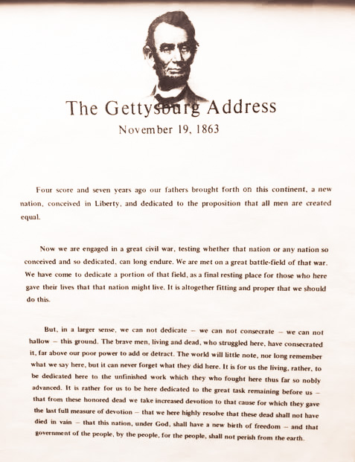

Slide 41
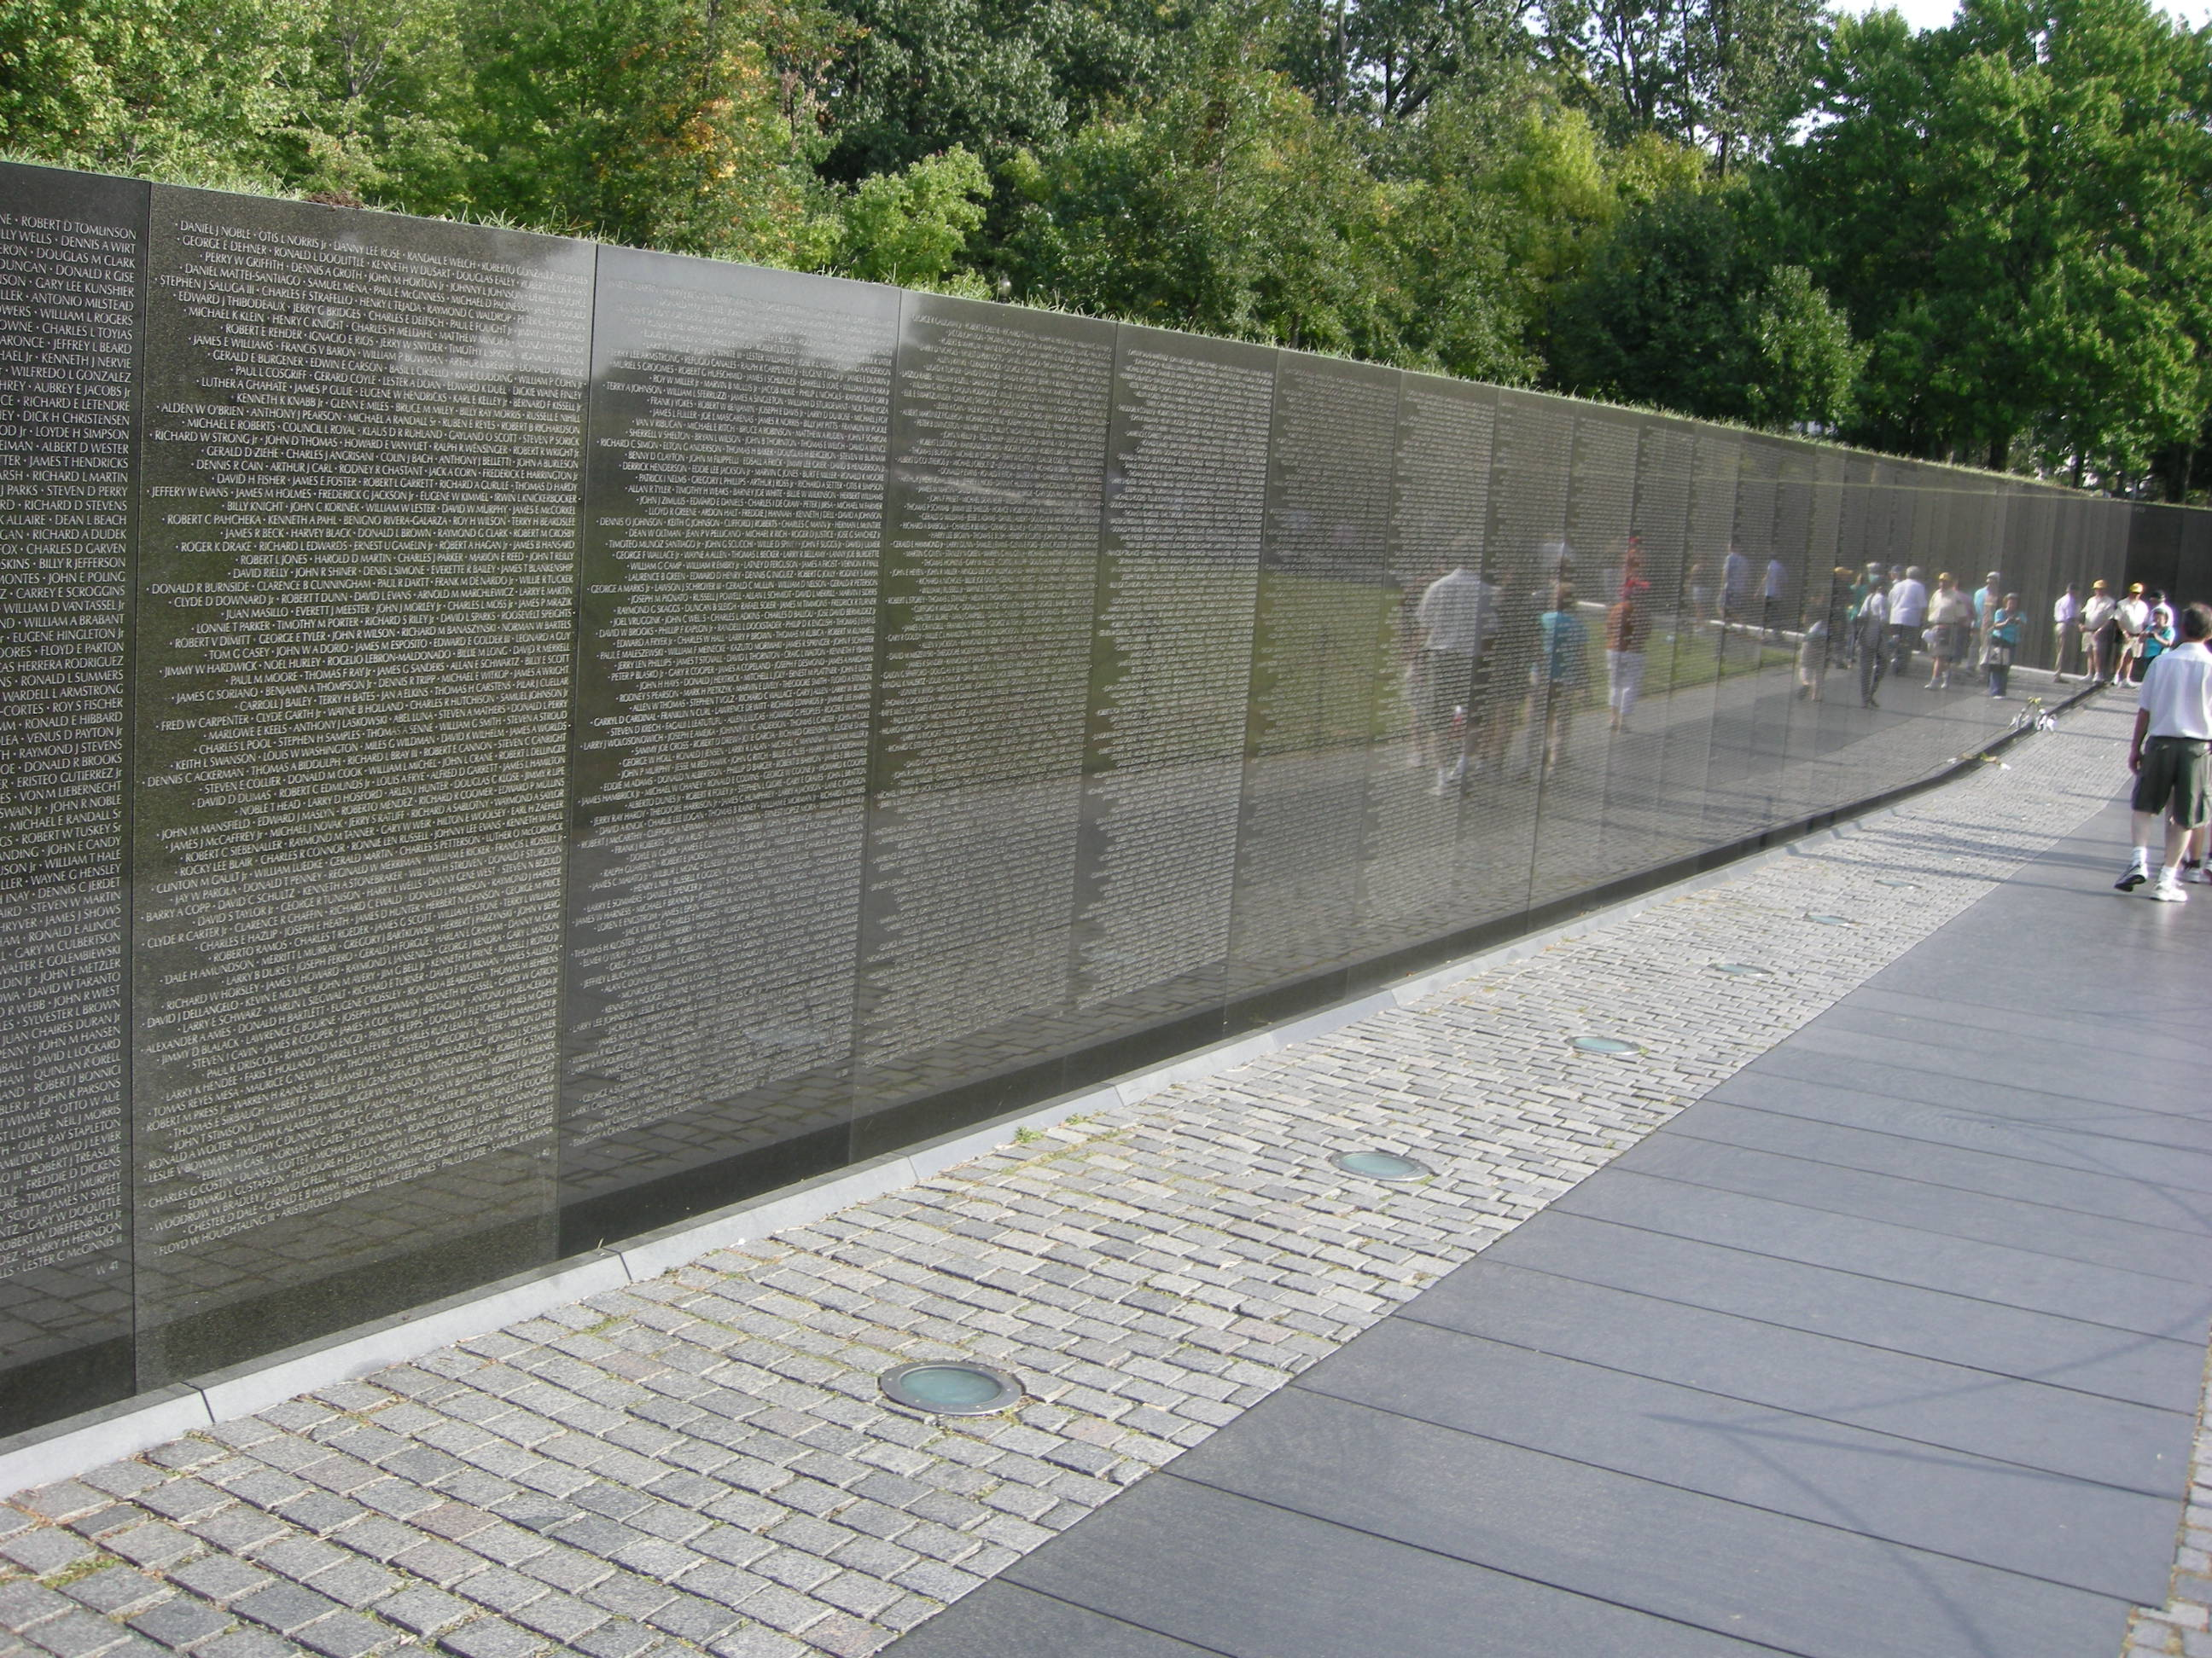

Slide 42
A Faith For
MARTYRS
Hebrews
11:32-40

