Slide 1
Acts 16:1-10

Slide 2
Proverbs 3:5-6
5. Trust in the Lord with all your heart,
and lean not on your own understanding;

Slide 3
Proverbs 3:5-6
6. In all your ways
acknowledge Him,
and He shall direct your paths.

Slide 4
Acts 16:1-10
1. Then he came to Derbe and Lystra. And behold, a certain disciple was there, named Timothy, the son of a certain Jewish woman who believed, but his father was Greek.

Slide 5
Acts 16:1-10
2. He was well spoken of by the brethren who were at Lystra and Iconium.

Slide 6
Acts 16:1-10
3. Paul wanted to have him go on with him. And he took him and circumcised him because of the Jews who were in that region, for they knew that his father was Greek.

Slide 7
Acts 16:1-10
4. And as they went through the cities, they delivered to them the decrees to keep, which were determined by the apostles and elders at Jerusalem.

Slide 8
Acts 16:1-10
5. So the churches were strengthened in the faith, and increased in number daily.

Slide 9
Acts 16:1-10
6. Now when they had gone through Phrygia and the region of Galatia, they were forbidden by the Holy Spirit to preach the word in Asia.

Slide 10
Acts 16:1-10
7. After they had come to Mysia, they tried to go into Bithynia, but the Spirit did not permit them.

Slide 11
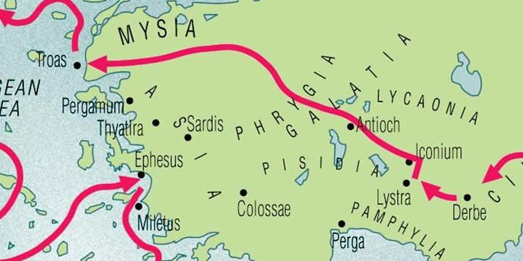

Slide 12
God didn’t tell Paul WHERE
he would end up.

Slide 13
God stopped Paul from doing what he wanted without telling him WHY.

Slide 14
God allowed physical and emotional trials without telling for HOW LONG.

Slide 15
Acts 16:8-10
8. So passing by Mysia,
they came down to Troas.

Slide 16
Acts 16:8-10
9. And a vision appeared to Paul in the night. A man of Macedonia stood and pleaded with him, saying “Come over to Macedonia and help us.”

Slide 17
Acts 16:8-10
10. Now after he had seen the vision, immediately we sought to go to Macedonia, concluding that the Lord had called us to preach the gospel to them.

Slide 18
Give God PERMISSION
to take His time.

Slide 19
Know that God DESIRES for you to discover His will.

Slide 20
LOOK at your “stops” carefully:

Slide 21
First, from your KNEES.

Slide 22
Second, through SCRIPTURE.

Slide 23
Third, through GODLY counsel.

Slide 24
Acts 16:1-10

