Slide 1
What’s In Your
Footlocker?
Genesis 4:1-10
Hebrews 11:1-4

Slide 2
Hebrews 11:1-4
1. Now faith is the substance of things hoped for, the evidence of things not seen.

Slide 3
Hebrews 11:1-4
2. For by it the elders obtained a good testimony.

Slide 4
Hebrews 11:1-4
3. By faith we understand that the worlds were framed by the word of God, so that the things which are seen were not made of things which are visible.

Slide 5
Hebrews 11:1-4
4. By faith Abel offered to God a more excellent sacrifice than Cain, through which he obtained witness that he was righteous, God testifying of his gifts;

Slide 6
Hebrews 11:1-4
and through it he being dead still speaks.

Slide 7
Genesis 4:1-10
1. Now Adam knew Eve his wife, and she conceived and bore Cain, and said, “I have acquired a man from the Lord.”

Slide 8
Genesis 4:1-10
2. Then she bore again, this time his brother Abel. Now Abel was a keeper of sheep, but Cain was a tiller of the ground.

Slide 9
Genesis 4:1-10
3. And in the process of time it came to pass that Cain brought an offering of the fruit of the ground to the Lord.

Slide 10
Genesis 4:1-10
4. Abel also brought of the firstborn of his flock and of their fat. And the Lord respected Abel and his offering,

Slide 11
Genesis 4:1-10
5. but He did not respect Cain and his offering. And Cain was very angry, and his countenance fell.

Slide 12
Genesis 4:1-10
6. So the Lord said to Cain, “Why are you angry? And why has your countenance fallen?

Slide 13
Genesis 4:1-10
7. If you do well, will you not be accepted? And if you do not do well, sin lies at the door. And its desire is for you, but you should rule over it.”

Slide 14
Genesis 4:1-10
8. Now Cain talked with Abel his brother; and it came to pass, when they were in the field, that Cain rose up against Abel his brother and killed him.

Slide 15
Genesis 4:1-10
9. Then the Lord said to Cain, “Where is Abel your brother?” He said, “I do not know. Am I my brother’s keeper?”

Slide 16
Genesis 4:1-10
10. And He said, “What have you done? The voice of your brother’s blood cries out to Me from the ground.

Slide 17
1 John 3:11-12
11. For this is the message that you heard from the beginning, that we should love one another,

Slide 18
1 John 3:11-12
12. not as Cain who was of the wicked one and murdered his brother. And why did he murder him? Because his works were evil and his brother’s righteous.

Slide 19
Proverbs 21:27
27. The sacrifice of the wicked is an abomination; how much more when he brings it with wicked intent!

Slide 20
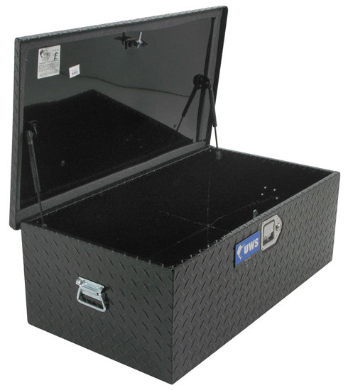

Slide 21
What’s In Your
Footlocker?
Genesis 4:1-10
Hebrews 11:1-4

