Slide 1
Acts 17:1-14

Slide 3
Jeremiah 38:2-3
2. “Thus says the Lord: ‘He who remains in this city shall die by the sword, by famine, and by pestilence; but he who goes over to the Chaldeans shall live;

Slide 4
Jeremiah 38:2-3
his life shall be as a prize to him, and he shall live.’

Slide 5
Jeremiah 38:2-3
3. Thus says the Lord: ‘This city shall surely be given into the hand of the king of Babylon’s army, which shall take it.’”

Slide 6
Jeremiah 38:4
4. Therefore the princes said to the king, “Please, let this man be put to death, for thus he weakens the hands of the men of war who remain in this city, and the hands of all

Slide 7
Jeremiah 38:4
the people, by speaking such words to them. For this man does not seek the welfare of this people, but their harm.”

Slide 8
Amos 7:10-12
10. Then Amaziah the priest of Bethel sent to Jeroboam king of Israel, saying, “Amos has conspired against you in the midst of the house of Israel. The land is not able to bear all his words.

Slide 9
Amos 7:10-12
11. For thus Amos has said: ‘Jeroboam shall die by the sword, and Israel shall surely be led away captive from their own land.’”

Slide 10
Amos 7:10-12
12. Then Amaziah said to Amos: “Go, you seer! Flee to the land of Judah. There eat bread, and there prophesy.

Slide 11
Acts 17:1-14
1. Now when they had passed through Amphipolis and Apollonia, they came to Thessalonica, where there was a synagogue of the Jews.

Slide 12
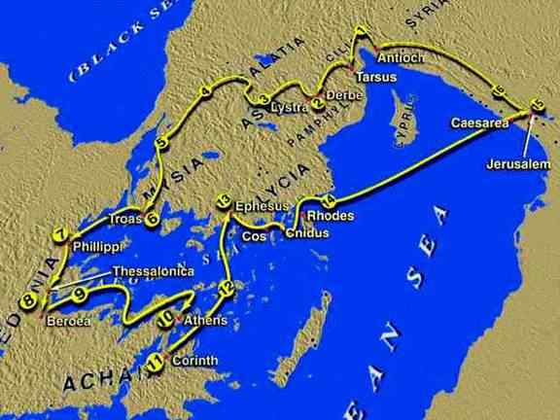

Slide 13
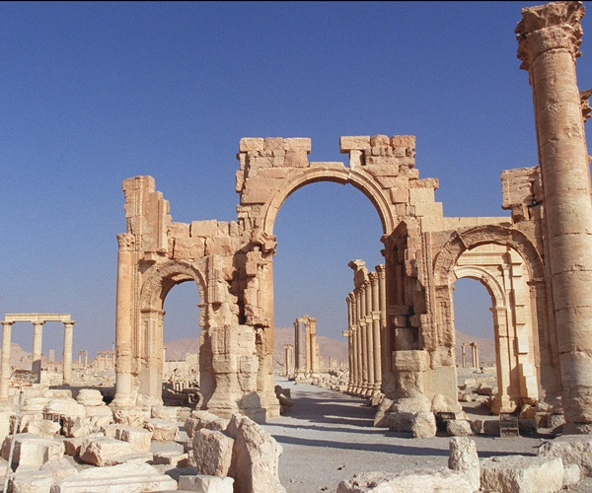

Slide 14
Acts 17:1-14
2. Then Paul, as his custom was, went in to them, and for three Sabbaths reasoned with them from the Scriptures,

Slide 15
Acts 17:1-14
3. explaining and demonstrating that the Christ had to suffer and rise again from the dead, and saying, “This Jesus whom I preach to you is the Christ.”

Slide 16
Acts 17:1-14
4. And some of them were persuaded; and a great multitude of the devout Greeks, and not a few of the leading women, joined Paul and Silas.

Slide 17
Acts 17:1-14
5. But the Jews who were not persuaded, becoming envious, took some of the evil men from the marketplace, and gathering a mob, set all the city in an uproar and attacked

Slide 18
Acts 17:1-14
the house of Jason, and sought to bring them out to the people.

Slide 19
Acts 17:1-14
6. But when they did not find them, they dragged Jason and some brethren to the rulers of the city, crying out, “These who have turned the world upside down have come here too.

Slide 20
Acts 17:1-14
7. Jason has harbored them, and these are all acting contrary to the decrees of Caesar, saying there is another king – Jesus.”

Slide 21
Acts 17:1-14
8. And they troubled the crowd and the rulers of the city when they heard these things.

Slide 22
Acts 17:1-14
9. So when they had taken security from Jason and the rest, they let them go.

Slide 23
Acts 17:1-14
10. Then the brethren immediately sent Paul and Silas away by night to Berea. When they arrived, they went into the synagogue of the Jews.

Slide 24
Acts 17:1-14
11. These were more fair-minded than those in Thessalonica, in that they received the word with all readiness, and searched the Scriptures daily to find out whether these things were so.

Slide 25
Acts 17:1-14
12. Therefore many of them believed, and also not a few of the Greeks, prominent women as well as men.

Slide 26
Acts 17:1-14
13. But when the Jews from Thessalonica learned that the word of God was preached by Paul at Berea, they came there also and stirred up the crowds.

Slide 27
Acts 17:1-14
14. Then immediately the brethren sent Paul away, to go to the sea; but both Silas and Timothy remained there.

Slide 28
We must know
WHO God is.

Slide 29
We must
STUDY
to know Him.

Slide 30
We must
CULTIVATE
a close relationship with God.

Slide 31
2 Timothy 2:15
15. Be diligent to present yourself approved to God, a worker who does not need to be ashamed, rightly dividing the word of truth.

Slide 32
Our DESIRE
must become
DISCIPLINE.

Slide 33
We must
APPLY
what we learn.

Slide 34
James 1:22
22. But be doers of the word, and not hearers only, deceiving yourselves.

Slide 35
We must share Christ
INTENTIONALLY.

Slide 36
1 Peter 3:15
15. But sanctify the Lord God in your hearts, and always be ready to give a defense to everyone who asks you a reason for the hope that is in you, with meekness and fear;

Slide 37
We must see opposition as
OPPORTUNITY.

Slide 39
Acts 17:1-14

