Slide 1
The
Power
of
Abraham’s
Faith
Hebrews 11

Slide 2
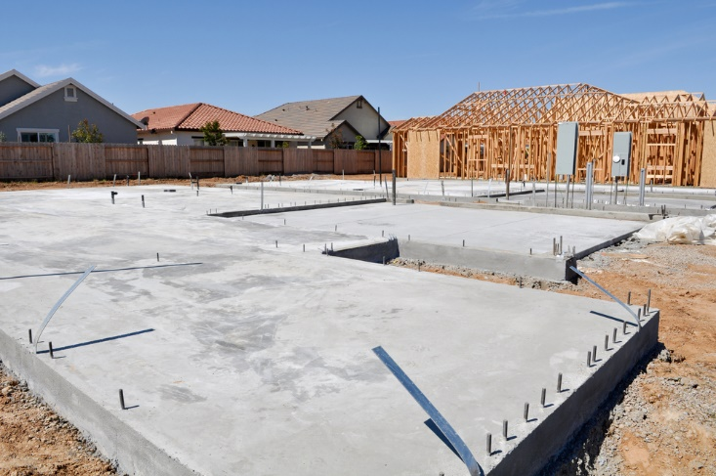

Slide 3
Abraham’s faith enabled him to obey when he did NOT know WHERE he was going.

Slide 4
Hebrews 11:8
8. By faith Abraham obeyed when he was called to go out to the place which he would receive as an inheritance. And he went out, not knowing where he was going.

Slide 5
Faith enables us to
UNDERSTAND what God says.

Slide 6
2 Corinthians 3:15-16
15. But even to this day, when Moses is read, a veil lies on their heart.

Slide 7
2 Corinthians 3:15-16
16. Nevertheless when one turns to the Lord, the veil is taken away.

Slide 8
Faith comes through hearing
SCRIPTURE.

Slide 9
Romans 10:17
17. So then faith comes by hearing, and hearing by the word of God.

Slide 10
Abraham’s faith enabled him to live with
ETERNITY in view.

Slide 11
Hebrews 11:9-10
9. By faith he dwelt in the land of promise as in a foreign country, dwelling in tents with Isaac and Jacob, the heirs with him of the same promise;

Slide 12
Hebrews 11:9-10
10. for he waited for the city which has foundations, whose builder and maker is God.

Slide 13
1 Peter 2:11
11. Beloved, I beg you as sojourners and pilgrims, abstain from fleshly lusts which war against the soul,

Slide 14
Abraham’s faith enabled him to obey when he did not know HOW God‘s will would be done.

Slide 15
Hebrews 11:11-12
11. By faith Sarah herself also received strength to conceive seed, and she bore a child when she was past the age, because she judged Him faithful who had promised.

Slide 16
Hebrews 11:11-12
12. Therefore from one man, and him as good as dead, were born as many as the stars of the sky in multitude – innumerable as the sand which is by the seashore.

Slide 17
Luke 1:34-37
34. Then Mary said to the angel, “How can this be, since I do not know a man?” …

Slide 18
Luke 1:34-37
37. For with God nothing will be impossible.”

Slide 19
Abraham’s faith enabled him to obey even when he did not know WHEN God would fulfill the promise.

Slide 20
Hebrews 11:13-18
13. These all died in faith, not having received the promises, but having seen them afar off were assured of them, embraced them and confessed that they were strangers and pilgrims on the earth.

Slide 21
Faith waits for God’s PERFECT TIME.

Slide 22
We are to obey
WHILE we wait.

Slide 23
Abraham’s faith enabled him to believe God even when
TESTED.

Slide 24
Hebrews 11:17-19
17. By faith Abraham, when he was tested, offered up Isaac, and he who had received the promises offered up his only begotten son,

Slide 25
Hebrews 11:17-19
18. of whom it was said, “In Isaac your seed shall be called,”

Slide 26
Hebrews 11:17-19
19. concluding that God was able to raise him up, even from the dead, from which he also received him in a figurative sense.

Slide 27
Abraham’s faith enabled God to declare him
RIGHTEOUS.

Slide 28
Romans 4:19-25
19. And not being weak in faith, he did not consider his own body, already dead (since he was about a hundred years old), and the deadness of Sarah’s womb.

Slide 29
Romans 4:19-25
20. He did not waver at the promise of God through unbelief, but was strengthened in faith, giving glory to God,

Slide 30
Romans 4:19-25
21. and being fully convinced that what He had promised He was also able to perform.

Slide 31
Romans 4:19-25
22. And therefore “it was accounted to him for righteousness.”

Slide 32
Romans 4:19-25
23. Now it was not written for his sake alone that it was imputed to him,

Slide 33
Romans 4:19-25
24. but also for us. It shall be imputed to us who believe in Him who raised up Jesus our Lord from the dead,

Slide 34
Romans 4:19-25
25. who was delivered up because of our offenses, and was raised because of our justification.

Slide 35
The
Power
of
Abraham’s
Faith
Hebrews 11

