Slide 1
Noah’s
REAL FAITH
Hebrews 11:7
Genesis 6:13-22

Slide 2
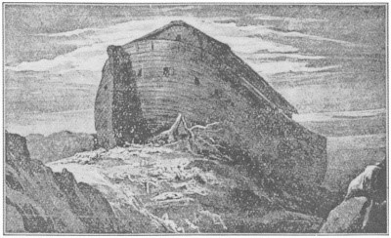

Slide 3
Hebrews 11:7
7. By faith Noah, being divinely warned of things not yet seen, moved with godly fear, prepared an ark for the saving of his household, by which he condemned the world

Slide 4
Hebrews 11:7
and became heir of the righteousness which is according to faith.

Slide 5
Genesis 6:13-22
13. And God said to Noah, “The end of all flesh has come before Me, for the earth is filled with violence through them; and behold, I will destroy them with the earth.

Slide 6
Genesis 6:13-22
14. Make yourself an ark of gopherwood; make rooms in the ark, and cover it inside and outside with pitch.

Slide 7
Genesis 6:13-22
15. And this is how you shall make it: the length of the ark shall be three hundred cubits, its width fifty cubits, and its height thirty cubits.

Slide 8
Genesis 6:13-22
16. You shall make a window for the ark, and you shall finish it to a cubit from above; and set the door of the ark in its side. You shall make it with lower, second, and third decks.

Slide 9
Genesis 6:13-22
17. And behold, I Myself am bringing floodwaters on the earth, to destroy from under heaven all flesh in which is the breath of life; everything that is on the earth shall die.

Slide 10
Genesis 6:13-22
18. But I will establish My covenant with you; and you shall go into the ark – you, your sons, your wife, and your sons’ wives with you.

Slide 11
Genesis 6:13-22
19. And of every living thing of all flesh you shall bring two of every sort into the ark, to keep them alive with you; they shall be male and female.

Slide 12
Genesis 6:13-22
20. Of the birds after their kind, of animals after their kind, and of every creeping thing of the earth after its kind, two of every kind will come to you to keep them alive.

Slide 13
Genesis 6:13-22
21. And you shall take for yourself of all food that is eaten, and you shall gather it to yourself; and it shall be food for you and for them.”

Slide 14
Genesis 6:13-22
22. Thus Noah did; according to all that God commanded him, so he did.

Slide 15
Real faith will
RESPOND
in obedience to
God’s Word.

Slide 16
Faith will respond
COMPLETELY.

Slide 17
Faith will respond
CONTINUALLY.

Slide 18
Faith will obey
REVERENTLY.

Slide 19
Real faith will obey
no matter how
BIG the COMMAND.

Slide 20
Real faith is a
WITNESS to the
world.

Slide 21
Real faith
TRUSTS God
COMPLETELY.

Slide 22
Real faith
REBUKES the world.

Slide 23
Noah’s
REAL FAITH
Hebrews 11:7
Genesis 6:13-22

