Slide 1
NAMES OF
M
H
ESSIA

Slide 2
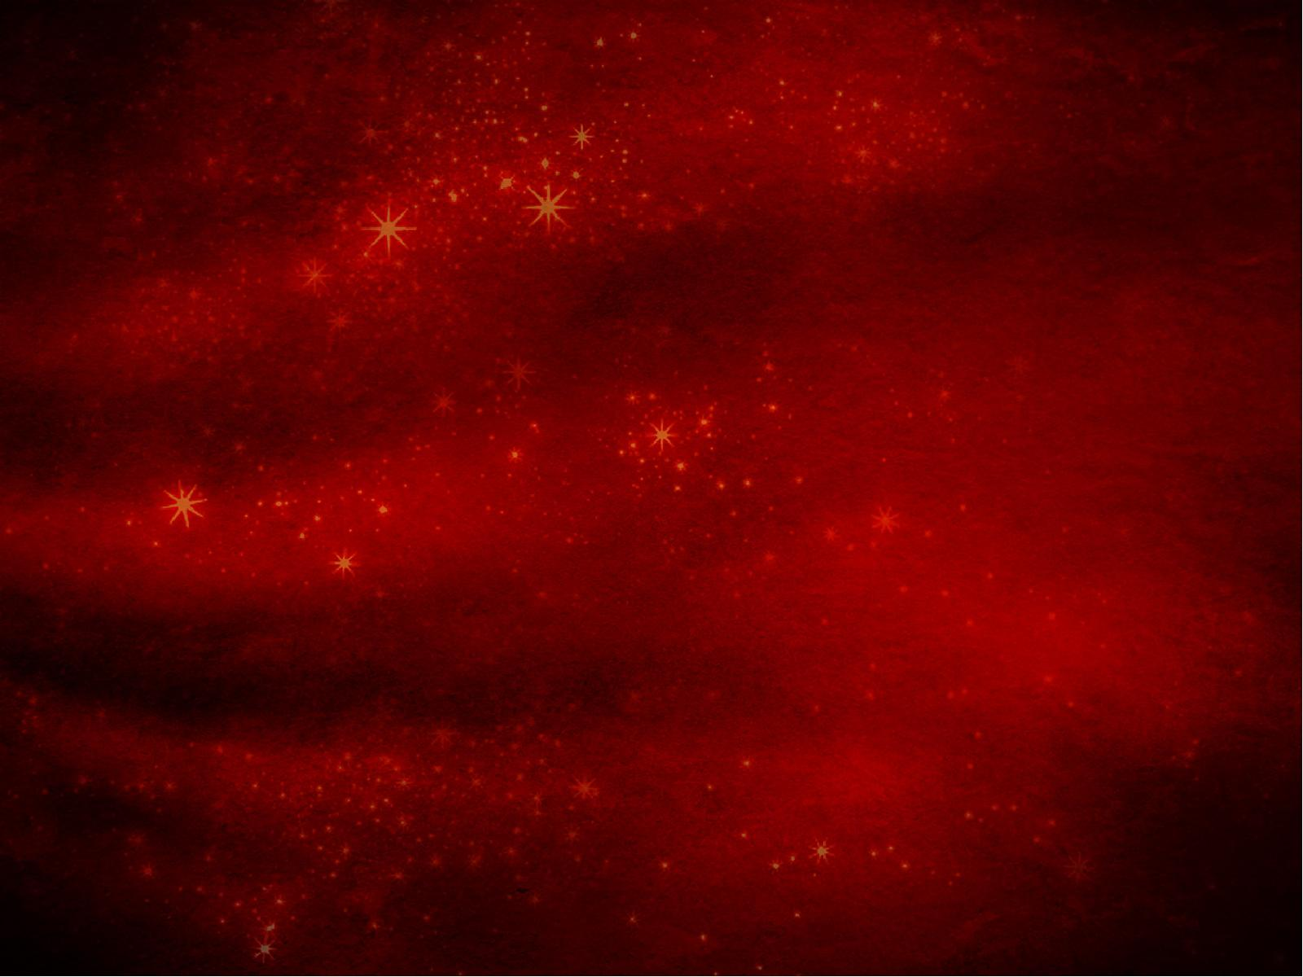
Isaiah 9:6
6. For unto us a Child is born, unto us a Son is given; and the government will be upon His shoulder. And His name will be called Wonderful, Counselor, Mighty God, Everlasting Father, Prince of Peace.

Slide 3
Philippians 2:10-11
10. that at the name of Jesus every knee should bow,…

Slide 4
Philippians 2:10-11
11. and that every tongue should confess that Jesus Christ is Lord, to the glory of God the Father.

Slide 5
His name is
WONDERFUL.

Slide 6
Psalm 40:5
5. Many, O Lord my God, are Your wonderful works which You have done…

Slide 7
Psalm 105:5
5. Remember His marvelous works which He has done, His wonders,…

Slide 8
Daniel 4:2-3
2. I thought it good to declare the signs and wonders that the Most High God has worked for me.

Slide 9
Daniel 4:2-3
3. How great are His signs,…

Slide 10
His name is
COUNSELOR.

Slide 11
Hebrews 4:15
15. For we do not have a High Priest who cannot sympathize with our weaknesses, but was in all points tempted as we are, yet without sin.

Slide 12
James 1:5
5. If any of you lacks wisdom, let him ask of God, who gives to all liberally and without reproach, and it will be given to him.

Slide 13
1 Peter 5:7
7. casting all your care upon Him, for He cares for you.

Slide 14
His name is
MIGHTY GOD.

Slide 15
Luke 2:7
7. And she brought forth her firstborn Son, and wrapped Him in swaddling cloths, and laid Him in a manger, because there was no room for them in the inn.

Slide 16
His name is
EVERLASTING FATHER.

Slide 17
Matthew 28:20
20. …lo, I am with you always, even to the end of the age.” Amen.

Slide 18
Hebrews 13:8
8. Jesus Christ is the same yesterday, today, and forever.

Slide 19
His name is
PRINCE OF PEACE.

Slide 20
NAMES OF
M
H
ESSIA

