Slide 1
Acts 17:15-34

Slide 2
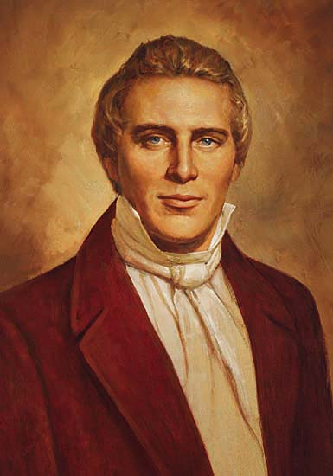
Joseph Smith
1805-1844

Slide 3
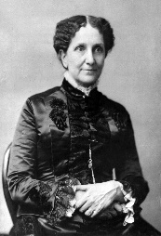
Mary Baker
Eddy
1821-1910

Slide 4
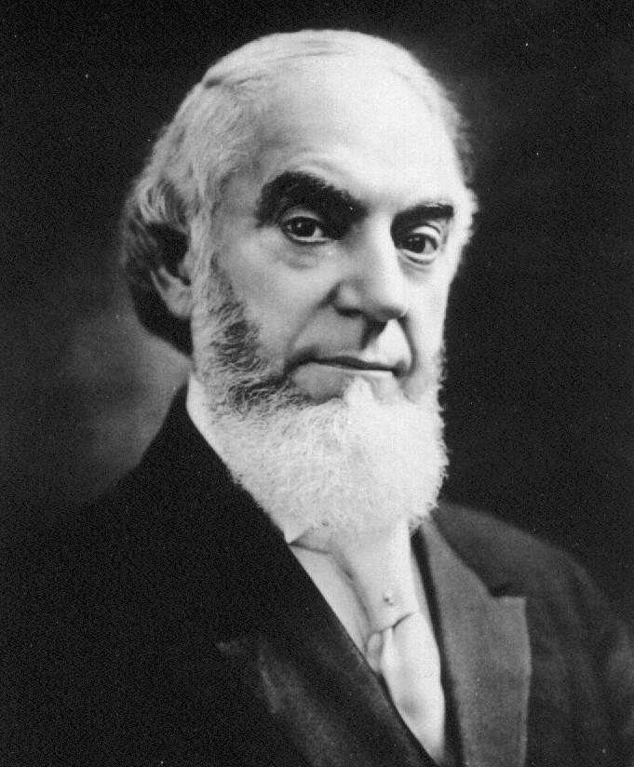
Charles Taze
Russell
1852-1916

Slide 5
Who CHRIST is.

Slide 6
1 John 4:1-5
1. Beloved, do not believe every spirit, but test the spirits, whether they are of God; because many false prophets have gone out into the world.

Slide 7
1 John 4:1-5
2. By this you know the Spirit of God: Every spirit that confesses that Jesus Christ has come in the flesh is of God,

Slide 8
1 John 4:1-5
3. and every spirit that does not confess that Jesus Christ has come in the flesh is not of God. And this is the spirit of the Antichrist, which you have heard was coming, and is now
already in the world.

Slide 9
1 John 4:1-5
4. You are of God, little children, and have overcome them, because He who is in you is greater than he who is in the world.

Slide 10
1 John 4:1-5
5. They are of the world. Therefore they speak as of the world, and the world hears them.

Slide 11
1 John 2:21
21. I have not written to you because you do not know the truth, but because you know it, and that no lie is of the truth.

Slide 12
We are to judge when
people rebel against
SCRIPTURE.

Slide 13
We are to judge our
RELATIONSHIP
with Christ.

Slide 14
We are to judge
EVERYTHING
according to Scripture.

Slide 15
1 Corinthians 2:15
15. But he who is spiritual judges all things, yet he himself is rightly judged by no one.

Slide 16
Acts 17:15-34
15. So those who conducted Paul brought him to Athens; and receiving a command for Silas and Timothy to come to him with all speed, they departed.

Slide 17
Acts 17:15-34
16. Now while Paul waited for them at Athens, his spirit was provoked within him when he saw that the city was given over to idols.

Slide 18
Acts 17:15-34
17. Therefore he reasoned in the synagogue with the Jews and with the Gentile worshipers, and in the marketplace daily with those who happened to be there.

Slide 19
Acts 17:15-34
18. Then certain Epicurean and Stoic philosophers encountered him. And some said, “What does this babbler want to say?” Others said, “He seems to be a proclaimer

Slide 20
Acts 17:15-34
of foreign gods,” because he preached to them Jesus and the resurrection.

Slide 21
Acts 17:15-34
19. And they took him and brought him to the Areopagus, saying, “May we know what this new doctrine is of which you speak?

Slide 22
Acts 17:15-34
20. For you are bringing some strange things to our ears. Therefore we want to know what these things mean.”

Slide 23
Acts 17:15-34
21. For all the Athenians and the foreigners who were there spent their time in nothing else but either to tell or to hear some new thing.

Slide 24
Acts 17:15-34
22. Then Paul stood in the midst of the Areopagus and said, “Men of Athens, I perceive that in all things you are very religious;

Slide 25
Acts 17:15-34
23. for as I was passing through and considering the objects of your worship, I even found an altar with this inscription:
TO THE UNKNOWN GOD

Slide 26
Acts 17:15-34
Therefore, the One whom you worship without knowing, Him I proclaim to you:

Slide 27
Acts 17:15-34
24. God, who made the world and everything in it, since He is Lord of heaven and earth, does not dwell in temples made with hands.

Slide 28
Acts 17:15-34
25. Nor is He worshiped with men’s hands, as though He needed anything, since He gives to all life, breath, and all things.

Slide 29
Acts 17:15-34
26. And He has made from one blood every nation of men to dwell on all the face of the earth, and has determined their preappointed times and the boundaries of their dwellings,

Slide 30
Acts 17:15-34
27. so that they should seek the Lord, in the hope that they might grope for Him and find Him, though He is not far from each one of us;

Slide 31
Acts 17:15-34
28. for in Him we live and move and have our being, as also some of your own poets have said, ‘For we are also His offspring.’

Slide 32
Acts 17:15-34
29. Therefore, since we are the offspring of God, we ought not to think that the Divine Nature is like gold or silver or stone, something shaped by art and man’s devising.

Slide 33
Acts 17:15-34
30. Truly, these times of ignorance God overlooked, but now commands all men everywhere to repent,

Slide 34
Acts 17:15-34
31. because He has appointed a day on which He will judge the world in righteousness by the Man whom He has ordained. He has given assurance of this to all by raising Him from the dead.

Slide 35
Acts 17:15-34
32. And when they heard of the resurrection of the dead, some mocked, while others said, “We will hear you again on this matter.”

Slide 36
Acts 17:15-34
33. So Paul departed from among them.

Slide 37
Acts 17:15-34
34. However, some men joined him and believed, among them Dionysius the Areopagite, a woman named Damaris, and others with them.

Slide 38
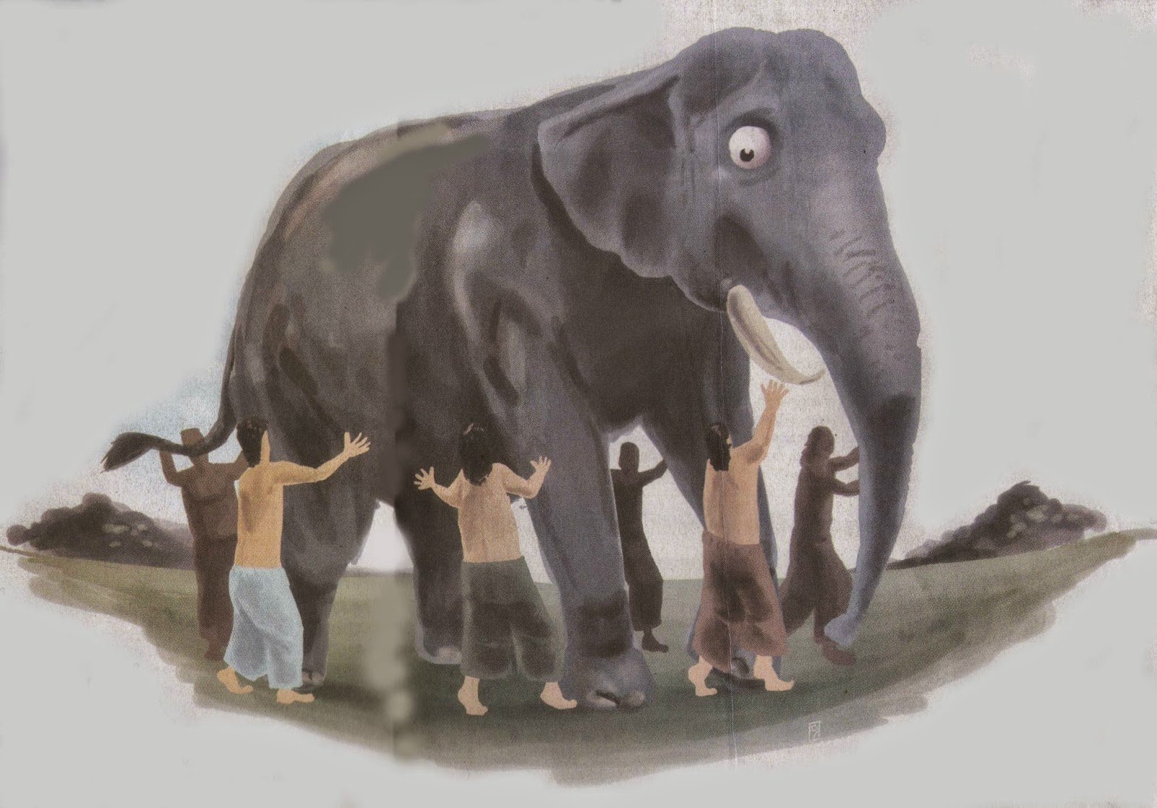

Slide 39
Acts 17:15-34

