Slide 1
Acts 18:8-17

Slide 2
1 Corinthians 2:3
3. I was with you in weakness, in fear, and in much trembling.

Slide 3
Acts 18:8-11
8. Then Crispus, the ruler of the synagogue, believed on the Lord with all his household. And many of the Corinthians, hearing, believed and were baptized.

Slide 4
Acts 18:8-11
9. Now the Lord spoke to Paul in the night by a vision, “Do not be afraid, but speak, and do not keep silent;

Slide 5
Acts 18:8-11
10. for I am with you, and no one will attack you to hurt you; for I have many people in this city.”

Slide 6
Acts 18:8-11
11. And he continued there a year and six months, teaching the word of God among them.

Slide 7
Encouragement increased his boldness in preaching.

Slide 8
Encouragement assured him of God’s presence.

Slide 9
Encouragement promised God’s protection.

Slide 10
Acts 18:12-17
12. When Gallio was proconsul of Achaia, the Jews with one accord rose up against Paul and brought him to the judgment seat,

Slide 11
Acts 18:12-17
13. saying, “This fellow persuades men to worship God contrary to the law.”

Slide 12
Acts 18:12-17
14. And when Paul was about to open his mouth, Gallio said to the Jews, “If it were a matter of wrongdoing or wicked crimes, O Jews, there would be reason why I should bear with you.

Slide 13
Acts 18:12-17
15. But if it is a question of words and names and your own law, look to it yourselves; for I do not want to be a judge of such matters.”

Slide 14
Acts 18:12-17
16. And he drove them from the judgment seat.

Slide 15
Acts 18:12-17
17. Then all the Greeks took Sosthenes, the ruler of the synagogue, and beat him before the judgment seat. But Gallio took no notice of these things.

Slide 16
John 16:12-13
12. “I still have many things to say to you, but you cannot bear them now.

Slide 17
John 16:12-13
13. However, when He, the Spirit of truth, has come, He will guide you into all truth; for He will not speak on His own authority, but whatever He bears He will speak; and He will tell you things to come.

Slide 18
Everyone must
FACE the truth.

Slide 19
Everyone should
SIDE WITH
the truth.

Slide 20
Everyone needs to
FOLLOW the truth.

Slide 21
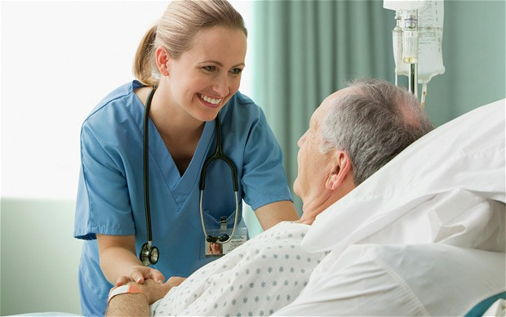

Slide 23
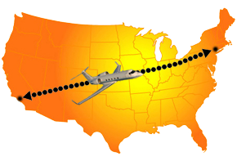

Slide 24
Acts 17:1-14

