Slide 1
FAITH
Gave a Fresh Start
Luke 17:11-19

Slide 2
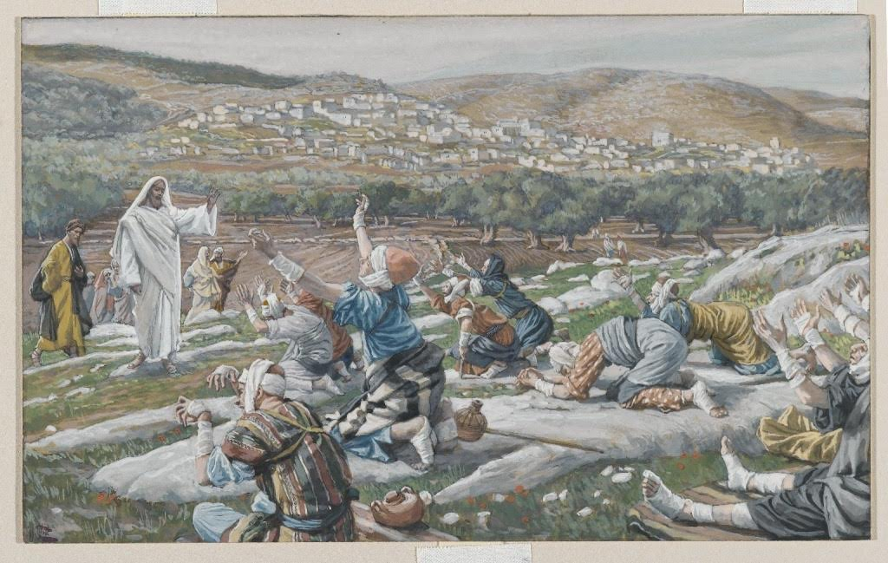

Slide 3
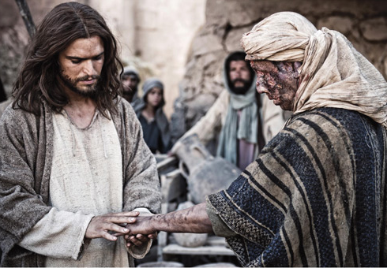

Slide 4
Luke 17:11-14
11. Now it happened as He went to Jerusalem that He passed through the midst of Samaria and Galilee.

Slide 5
Luke 17:11-14
12. Then as He entered a certain village, there met Him ten men who were lepers, who stood afar off.

Slide 6
Luke 17:11-14
13. And they lifted up their voices and said, “Jesus, Master, have mercy on us!”

Slide 7
Luke 17:11-14
14. So when He saw them, He said to them, “Go, show yourselves to the priests.” And so it was that as they went, they were cleansed.

Slide 8
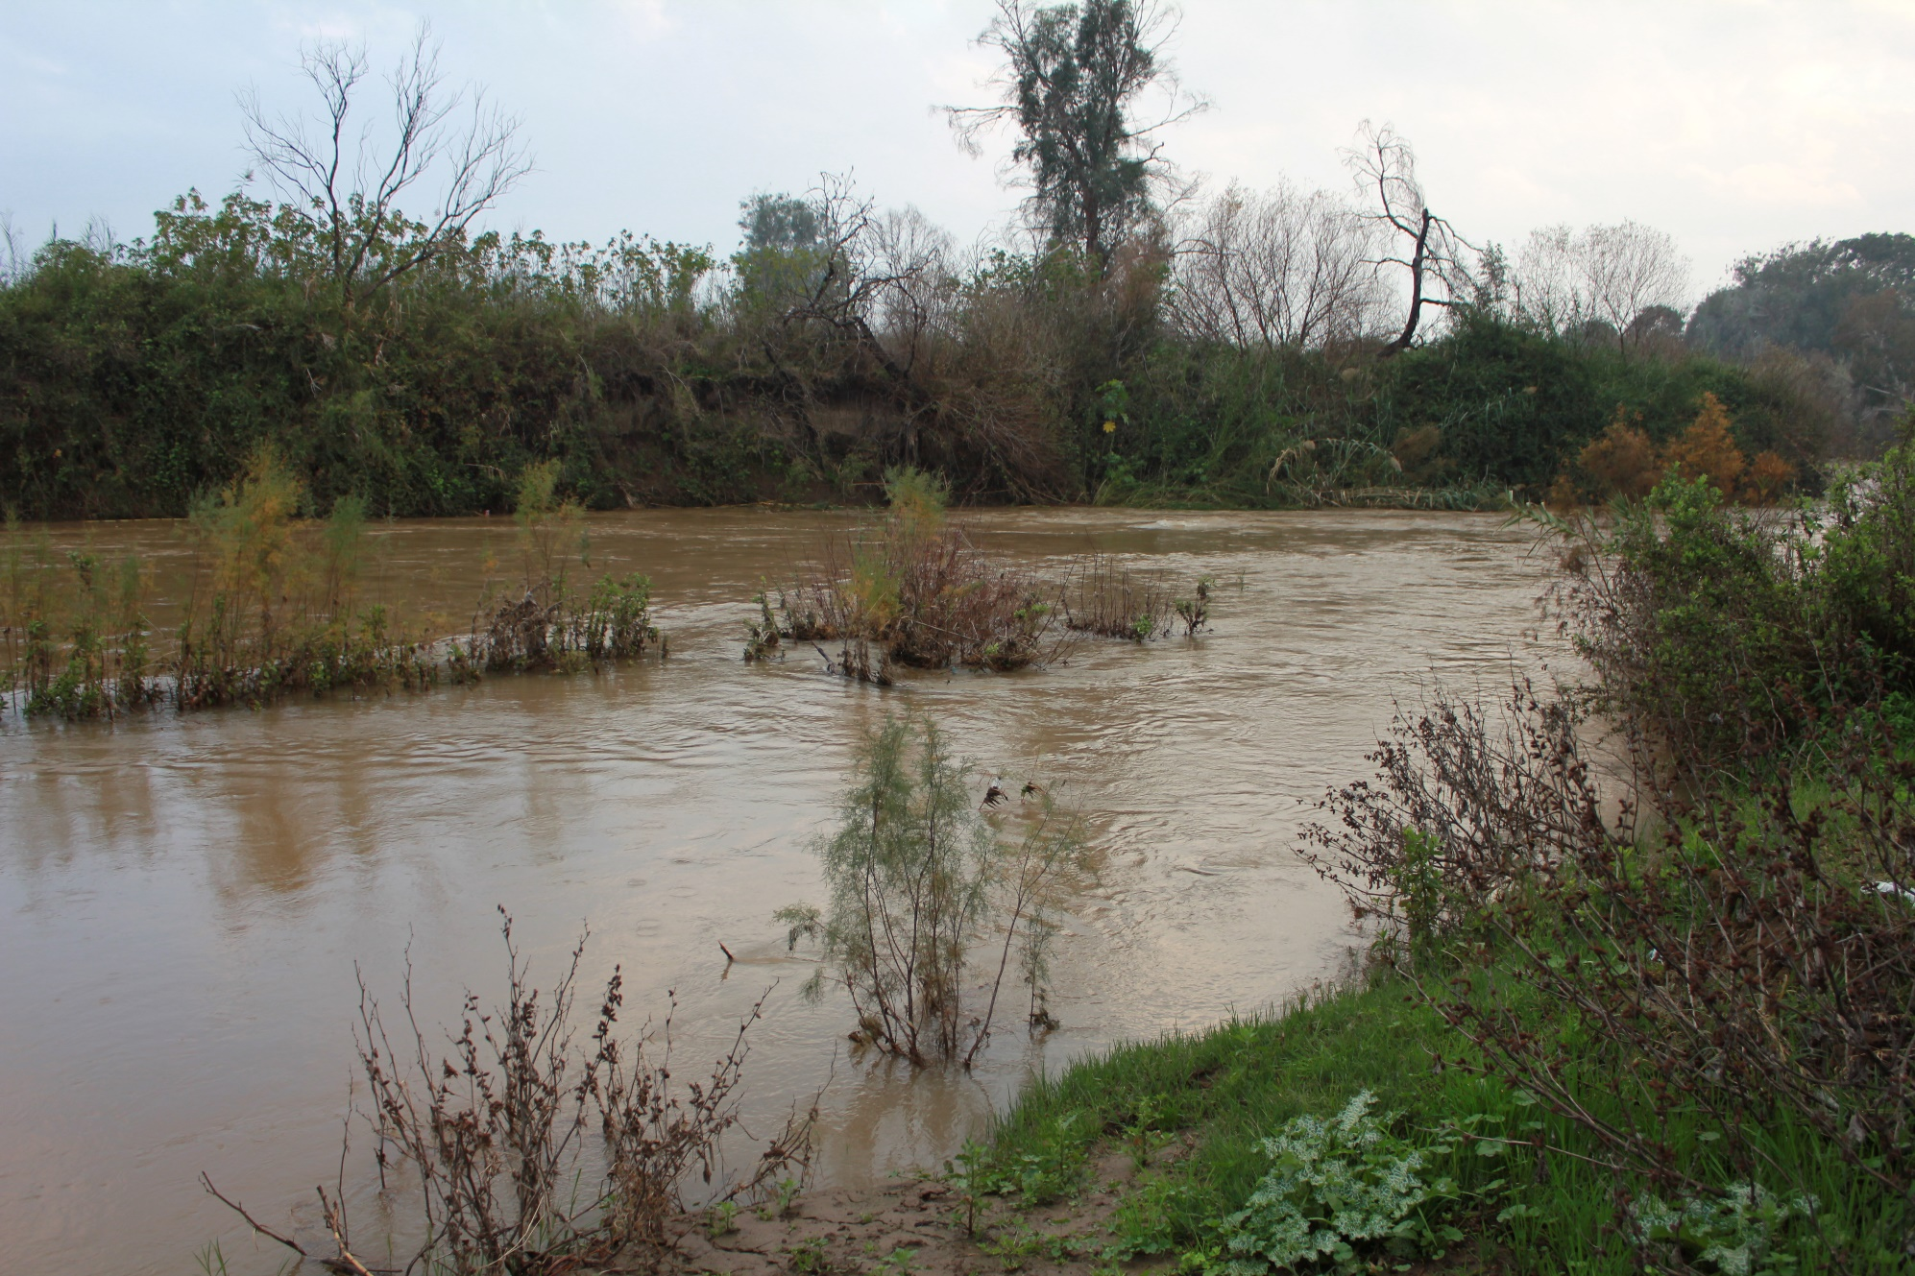

Slide 9
Luke 17:15-19
15. And one of them, when he saw that he was healed, returned, and with a loud voice glorified God,

Slide 10
Luke 17:15-19
16. and fell down on his face at His feet, giving Him thanks. And he was a Samaritan.

Slide 11
Luke 17:15-19
17. So Jesus answered and said, “Were there not ten cleansed? But where are the nine?

Slide 12
Luke 17:15-19
18. Were there not any found who returned to give glory to God except this foreigner?”

Slide 13
Luke 17:15-19
19. And He said to him, “Arise, go your way. Your faith has made you well.”

Slide 14
FAITH
Gave a Fresh Start
Luke 17:11-19

