Slide 1
Acts 18:1-10

Slide 2
Acts 18:1
1. After these things Paul departed from Athens and went to Corinth.

Slide 3
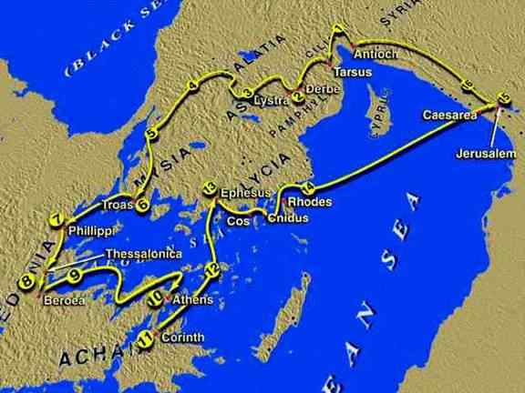

Slide 4
Acts 18:2-10
2. And he found a certain Jew named Aquila, born in Pontus, who had recently come from Italy with his wife Priscilla (because Claudius had commanded all the Jews to depart from Rome); and he came to them.

Slide 5
Acts 18:2-10
3. So, because he was of the same trade, he stayed with them and worked; for by occupation they were tentmakers.

Slide 6
Acts 18:2-10
4. And he reasoned in the synagogue every Sabbath, and persuaded both Jews and Greeks.

Slide 7
Acts 18:2-10
5. When Silas and Timothy had come from Macedonia, Paul was compelled by the Spirit, and testified to the Jews that Jesus is the Christ.

Slide 8
Acts 18:2-10
6. But when they opposed him and blasphemed, he shook his garments and said to them, “Your blood be upon your own heads; I am clean. From now on I will go to the Gentiles.”

Slide 9
Acts 18:2-10
7. And he departed from there and entered the house of a certain man named Justus, one who worshiped God, whose house was next door to the synagogue.

Slide 10
Acts 18:2-10
8. Then Crispus, the ruler of the synagogue, believed on the Lord with all his household. And many of the Corinthians, hearing, believed and were baptized.

Slide 11
Acts 18:2-10
9. Now the Lord spoke to Paul in the night by a vision, “Do not be afraid, but speak, and do not keep silent;

Slide 12
Acts 18:2-10
10. for I am with you, and no one will attack you to hurt you; for I have many people in this city.”

Slide 13
There is never an
EASY PLACE
to live for Christ.

Slide 14
There is never great opportunity without great
OPPOSITION.

Slide 15
There is never a time
when God will LEAVE
you on your own.

Slide 16
There is never a task
from God that will not
have ETERNAL rewards.

Slide 17
Acts 17:1-14

