Slide 1
A Royal Invitation
Psalm 100:1-5

Slide 2
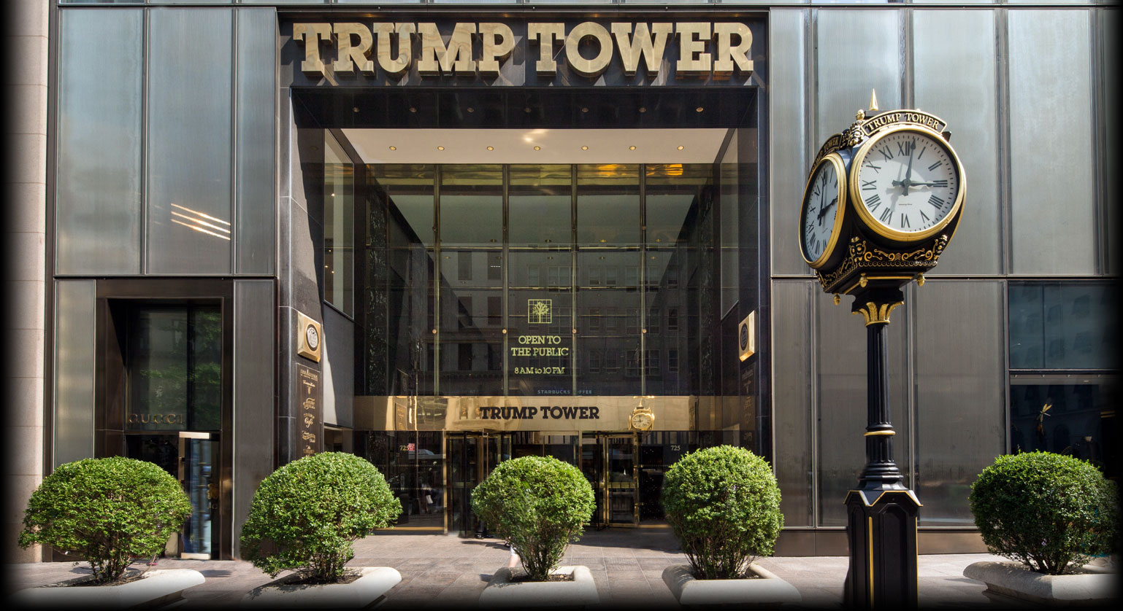

Slide 3
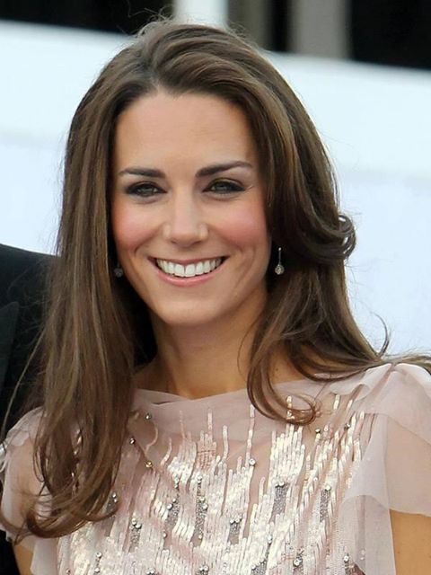

Slide 4
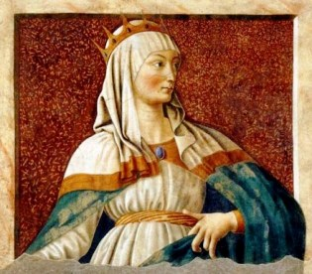

Slide 5
Esther 4:11
11. “All the king’s servants and the people of the king’s provinces know that any man or woman who goes into the inner court of the king, who has not been called, he has but one law:

Slide 6
Esther 4:11
put all to death, except the one to whom the king holds out the golden scepter, that he may live. Yet I myself have not been called to go in to the king these thirty days.”

Slide 7
Psalm 100:1-2
1. Make a joyful shout to the Lord, all you lands!

Slide 8
Psalm 100:1-2
2. Serve the Lord with gladness; Come before His presence with singing.

Slide 9
We are called to worship
God PASSIONATELY.

Slide 10
We are called to worship
God with GLADNESS.

Slide 11
We are called to worship
God with SINGING.

Slide 12
Job 38:7
7. When the morning stars sang together, and all the sons of God shouted for joy?

Slide 13
Psalm 100:3
3. Know that the Lord, He is God; It is He who has made us, and not we ourselves; We are His people and the sheep of His pasture.

Slide 14
We are called to worship
God with HUMILITY.

Slide 15
Psalm 100:4
4. Enter into His gates with thanksgiving, and into His courts with praise. Be thankful to Him, and bless His name.

Slide 16
We are called to worship
in His PRESENCE.

Slide 17
We are called to worship
God with GRATITUDE.

Slide 18
Psalm 100:5
5. For the Lord is good; His mercy is everlasting, and His truth endures to all generations.

Slide 19
We are called to worship
God with CONFIDENCE in Him.

Slide 20
We are called to worship
so we will be in TUNE with God.

Slide 22
A Royal Invitation
Psalm 100:1-5

