Slide 1
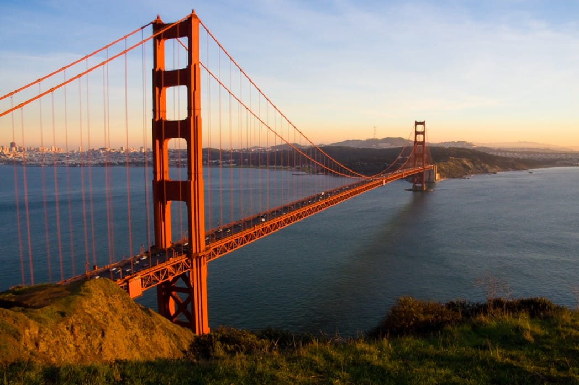
MOSES:
Intercessory Prayer
Exodus
32:7-24, 30-35

Slide 2
EXODUS 32:7-14
7. And the Lord said to Moses, “Go, get down! For your people whom you brought out of the land of Egypt have corrupted themselves.

Slide 3
EXODUS 32:7-14
8. They have turned aside quickly out of the way which I commanded them. They have made themselves a molded calf, and worshiped it and sacrificed to it, and said, ‘This is your god, O Israel, that brought you out of the land of Egypt!’”

Slide 4
EXODUS 32:7-14
9. And the Lord said to Moses, “I have seen this people, and indeed it is a stiff-necked people!

Slide 5
EXODUS 32:7-14
10. Now therefore, let Me alone, that My wrath may burn hot against them and I may consume them. And I will make of you a great nation.”

Slide 6
EXODUS 32:7-14
11. Then Moses pleaded with the Lord his God, and said: “Lord, why does Your wrath burn hot against Your people whom You have brought out of the land of Egypt with great power and with a mighty hand?

Slide 7
EXODUS 32:7-14
12. Why should the Egyptians speak, and say ‘He brought them out to harm them, to kill them in the mountains, and to consume them from the face of the earth’? Turn from Your fierce wrath, and relent from this harm to Your people.

Slide 8
EXODUS 32:7-14
13. Remember Abraham, Isaac, and Israel, Your servants, to whom You swore by Your own self, and said to them, ‘I will multiply your descendants as the stars of heaven; and all this land that I have spoken of I give to your descendants, and they shall inherit it forever.’”

Slide 9
EXODUS 32:7-14
14. So the Lord relented from the harm which He said He would do to His people.

Slide 10
EXODUS 32:15-24
15. And Moses turned and went down from the mountain, and the two tablets of the Testimony were in his hand. The tablets were written on both sides; on the one side and on the other they were written.

Slide 11
EXODUS 32:15-24
16. Now the tablets were the work of God, and the writing was the writing of God engraved on the tablets.

Slide 12
EXODUS 32:15-24
17. And when Joshua heard the noise of the people as they shouted, he said to Moses, “There is a noise of war in the camp.”

Slide 13
EXODUS 32:15-24
18. But he said: “It is not the noise of the shout of victory, nor the noise of the cry of defeat, but the sound of singing I hear.”

Slide 14
EXODUS 32:15-24
19. So it was, as soon as he came near the camp, that he saw the calf and the dancing. So Moses’ anger became hot, and he cast the tablets out of his hands and broke them at the foot of the mountain.

Slide 15
EXODUS 32:15-24
20. Then he took the calf which they had made, burned it in the fire, and ground it to powder; and he scattered it on the water and made the children of Israel
drink it.

Slide 16
EXODUS 32:15-24
21. And Moses said to Aaron, “What did this people do to you that you have brought so great a sin upon them?”

Slide 17
EXODUS 32:15-24
22. So Aaron said, “Do not let the anger of my lord become hot. You know the people, that they are set on evil.

Slide 18
EXODUS 32:15-24
23. For they said to me, ‘Make us gods that shall go before us; as for this Moses, the man who brought us out of the land of Egypt, we do not know what has become of him.’

Slide 19
EXODUS 32:15-24
24. And I said to them, ‘Whoever has any gold, let them break it off.’ So they gave it to me, and I cast it into the fire, and this calf came out.”

Slide 20
Needed to see
things HONESTLY.

Slide 21
Needed to accept SIN
for what it is.

Slide 22
Needed to
COME CLEAN.

Slide 23
Needed to realize there
is DISCIPLINE
for wrong doing.

Slide 24
EXODUS 32:30-35
30. Now it came to pass on the next day that Moses said to the people, “You have committed a great sin. So now I will go up to the Lord; perhaps I can make atonement for your sin.”

Slide 25
EXODUS 32:30-35
31. Then Moses returned to the Lord and said, “Oh, these people have committed a great sin, and have made for themselves a god of gold!

Slide 26
EXODUS 32:30-35
32. Yet now, if You will forgive their sin—but if not, I pray, blot me out of Your book which You have written.”

Slide 27
EXODUS 32:30-35
33. And the Lord said to Moses, “Whoever has sinned against Me, I will blot him out of My book.

Slide 28
EXODUS 32:30-35
34. Now therefore, go, lead the people to the place of which I have spoken to you. Behold, My Angel shall go before you. Nevertheless, in the day when I visit for punishment, I will visit punishment upon them for their sin.”

Slide 29
EXODUS 32:30-35
35. So the Lord plagued the people because of what they did with the calf which Aaron made.

Slide 30
EXODUS 33:7-11
7. Moses took his tent and pitched it outside the camp, far from the camp, and called it the tabernacle of meeting. And it came to pass that everyone who sought the Lord went out to the tabernacle of meeting which was outside the camp.

Slide 31
EXODUS 33:7-11
8. So it was, whenever Moses went out to the tabernacle, that all the people rose, and each man stood at his tent door and watched Moses until he had gone into the tabernacle.

Slide 32
EXODUS 33:7-11
9. And it came to pass, when Moses entered the tabernacle, that the pillar of cloud descended and stood at the door of the tabernacle, and the Lord talked with Moses.

Slide 33
EXODUS 33:7-11
10. All the people saw the pillar of cloud standing at the tabernacle door, and all the people rose and worshiped, each man in his tent door.

Slide 34
EXODUS 33:7-11
11. So the Lord spoke to Moses face to face, as a man speaks to his friend. And he would return to the camp, but his servant Joshua the son of Nun, a young man, did not depart from the tabernacle.

Slide 35
1 Timothy 2:1
1. Therefore I exhort first of all that supplications, prayers, intercessions, and giving of thanks be made for all men,

Slide 36
God is LOOKING FOR
intercessory prayers.

Slide 37
Ezekial 22:30
30. So I sought for a man among them who would make a wall, and stand in the gap before Me on behalf of the land, that I should not destroy it; but I found no one.

Slide 38
Isaiah 59:16
16. He saw that there was no man, and wondered that there was no intercessor; therefore His own arm brought salvation for Him; and His own righteousness, it sustained Him.

Slide 39
Psalm 106:23
23. Therefore He said that He would destroy them, had not Moses His chosen one stood before Him in the breach, to turn away His wrath, lest He destroy them.

Slide 40
If God is looking for intercessory prayers that means He LISTENS and ANSWERS them.

Slide 41
Intercessory prayer is praying for OTHERS.

Slide 43
People who are UNSAVED.

Slide 44
People who are
TOO WEAK or ill.

Slide 45
People who are
WEAK in the Word.

Slide 46
Times of CRISIS.

Slide 47
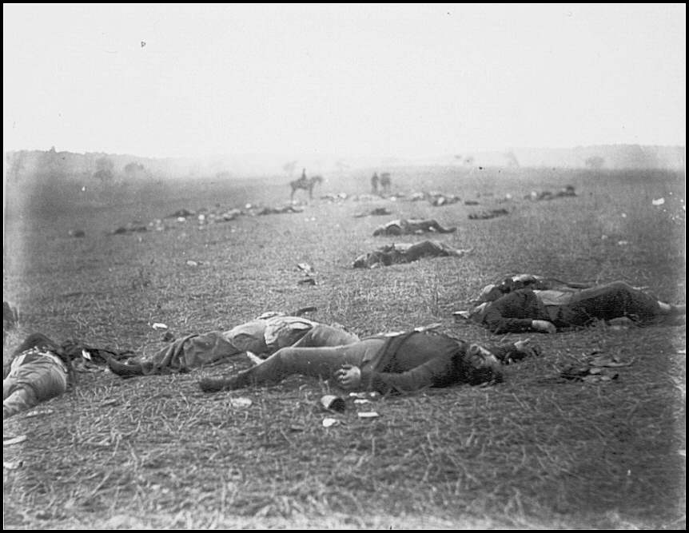

Slide 48
MOSES:
Intercessory Prayer
Exodus
32:7-24, 30-35

